Slide 1
Call & Register
Relay attack on WinReg RPC client

Slide 2
Agenda
MS-RPC introduction and overview
RPC Authentication and NTLM (relay)
Windows Remote Registry
Downgrade attack -> relay

Slide 3


whoami
Stiv Kupchik
Security Research Team Lead @ Akamai
@kupsul
Background in DFIR and Windows internals

Slide 4
MS-RPC Overview
Notes:
Let’s start with a quick RPC overview.

Slide 5
Terminology
Interface
{M}IDL
Transport
Endpoint
Binding
Notes:
After this section, if we do our job well, you’ll understand what every term on this slide means and how they relate to each other.

Slide 6
The RPC Client-Server Model
Server
Client
Notes:
RPC relies on a client-server model, [c] where the client wishes to invoke some functionality on the server side.
In order to have a common ground, the client and server agree upon an [c] interface.
The interface is specified in a file called IDL (stands for Interface Definition Language) and lists which functions the server exposes and their signature. Every interface has a name and a unique identifier in the form of UUID.
In order to refer to this interface and its functions, the client and server need header and source files, [c] which are produced by MIDL – Microsoft IDL compiler.
But how does the client know who to talk to in terms of network? →

Slide 7
The RPC Client-Server Model
Server
Foo(5, “Hello”)
Client
Notes:
RPC relies on a client-server model, [c] where the client wishes to invoke some functionality on the server side.
In order to have a common ground, the client and server agree upon an [c] interface.
The interface is specified in a file called IDL (stands for Interface Definition Language) and lists which functions the server exposes and their signature. Every interface has a name and a unique identifier in the form of UUID.
In order to refer to this interface and its functions, the client and server need header and source files, [c] which are produced by MIDL – Microsoft IDL compiler.
But how does the client know who to talk to in terms of network? →

Slide 8
The RPC Client-Server Model
Server
[ uuid(12345678-4000-2006-0000-20000000001a)
]
interface Test
{
void Foo([in] int number, [in] char *message);
void Bar([out] int * result);
}
Foo(5, “Hello”)
Client
Notes:
RPC relies on a client-server model, [c] where the client wishes to invoke some functionality on the server side.
In order to have a common ground, the client and server agree upon an [c] interface.
The interface is specified in a file called IDL (stands for Interface Definition Language) and lists which functions the server exposes and their signature. Every interface has a name and a unique identifier in the form of UUID.
In order to refer to this interface and its functions, the client and server need header and source files, [c] which are produced by MIDL – Microsoft IDL compiler.
But how does the client know who to talk to in terms of network? →

Slide 9
The RPC Client-Server Model
Server
[ uuid(12345678-4000-2006-0000-20000000001a)
]
interface Test
{
void Foo([in] int number, [in] char *message);
void Bar([out] int * result);
}
Test_s.c
Test.h
MIDL.exe
Foo(5, “Hello”)
Test_c.c
Client
Notes:
RPC relies on a client-server model, [c] where the client wishes to invoke some functionality on the server side.
In order to have a common ground, the client and server agree upon an [c] interface.
The interface is specified in a file called IDL (stands for Interface Definition Language) and lists which functions the server exposes and their signature. Every interface has a name and a unique identifier in the form of UUID.
In order to refer to this interface and its functions, the client and server need header and source files, [c] which are produced by MIDL – Microsoft IDL compiler.
But how does the client know who to talk to in terms of network? →

Slide 10
The RPC Client-Server Model
Server
[ uuid(12345678-4000-2006-0000-20000000001a)
]
interface Test
{
void Foo([in] int number, [in] char *message);
void Bar([out] int * result);
}
Test_s.c
Test.h
MIDL.exe
Foo(5, “Hello”)
Test_c.c
Client
Notes:
RPC relies on a client-server model, [c] where the client wishes to invoke some functionality on the server side.
In order to have a common ground, the client and server agree upon an [c] interface.
The interface is specified in a file called IDL (stands for Interface Definition Language) and lists which functions the server exposes and their signature. Every interface has a name and a unique identifier in the form of UUID.
In order to refer to this interface and its functions, the client and server need header and source files, [c] which are produced by MIDL – Microsoft IDL compiler.
But how does the client know who to talk to in terms of network? →

Slide 11
Endpoints
The server registers an endpoint using a certain transport
Transports | Protocol Sequence | Endpoints
TCP Named pipe UDP ALPC HTTP Hyper-V socket | ncacn_ip_tcp ncacn_np ncadg_ip_udp ncalrpc ncacn_http ncacn_hvsocket | <port number> <pipe name> <port number> <ALPC port> <hostname> <UUID>
Notes:
For this purpose RPC has the notion of endpoints.
Every server need to register an endpoint over a certain transport. Transports can be many things, TCP, UDP, etc., and the endpoint is a certain destination over this transport, a certain port, a hostname or a pipe name.
The relation between and interface and an endpoint is not 1-to-1: there can even be one endpoint exposing several interfaces, or several endpoints exposing a single interface.

Slide 12
Well-Known Endpoints
Dynamic Endpoints
Server
Foo(5, “Hello”)
[TCP port 39776]
Client
Notes:
With such a dedicated, or “well known” endpoint, the client knows in advance exactly what endpoint to request, and this port or pipe is either hardcoded into the client or specific in the interface IDL file.
With dynamic endpoints, the client asks an intermediary named the Endpoint Mapper for the server’s endpoint. The EPMapper has its own port, 135, which the client queries whenever they need to know which endpoint to connect to.

Slide 13
Well-Known Endpoints
Dynamic Endpoints
Server
EP Mapper
Server
Hi I need server <UUID>
[TCP port 135]
Foo(5, “Hello”)
[TCP port 39776]
Client
Client
Notes:
With such a dedicated, or “well known” endpoint, the client knows in advance exactly what endpoint to request, and this port or pipe is either hardcoded into the client or specific in the interface IDL file.
With dynamic endpoints, the client asks an intermediary named the Endpoint Mapper for the server’s endpoint. The EPMapper has its own port, 135, which the client queries whenever they need to know which endpoint to connect to.

Slide 14
Well-Known Endpoints
Dynamic Endpoints
Server
EP Mapper
Server
Ok talk to TCP port 50501
Hi I need server <UUID>
[TCP port 135]
Foo(5, “Hello”)
[TCP port 39776]
Client
Client
Notes:
With such a dedicated, or “well known” endpoint, the client knows in advance exactly what endpoint to request, and this port or pipe is either hardcoded into the client or specific in the interface IDL file.
With dynamic endpoints, the client asks an intermediary named the Endpoint Mapper for the server’s endpoint. The EPMapper has its own port, 135, which the client queries whenever they need to know which endpoint to connect to.

Slide 15
Well-Known Endpoints
Dynamic Endpoints
Server
EP Mapper
Server
Ok talk to TCP port 50501
Hi I need server <UUID>
[TCP port 135]
Foo(5, “Hello”)
[TCP port 39776]
Foo(5, “Hello”)
[TCP port 50501]
Client
Client
Notes:
With such a dedicated, or “well known” endpoint, the client knows in advance exactly what endpoint to request, and this port or pipe is either hardcoded into the client or specific in the interface IDL file.
With dynamic endpoints, the client asks an intermediary named the Endpoint Mapper for the server’s endpoint. The EPMapper has its own port, 135, which the client queries whenever they need to know which endpoint to connect to.

Slide 16
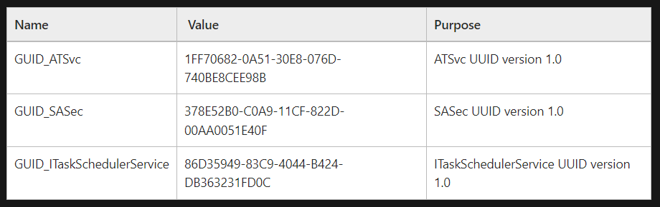
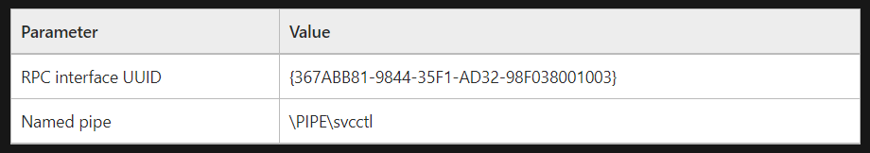
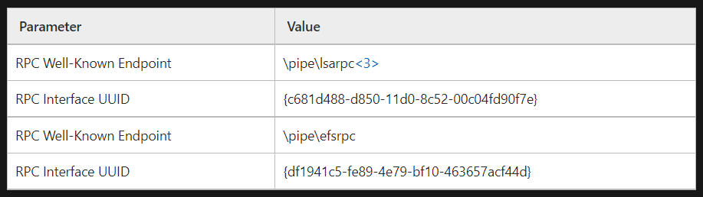
Task Scheduler Service Remoting Protocol
Service control manager remote protocol
Encrypting File System Remote (EFSRPC) Protocol
Notes:
If you look at Microsoft’s “technical documents” section, you’ll see every protocol has a page called “standard assignments”.
This page specifies the interface identifiers for the RPC server implementing the protocol, and if available, also a well-known endpoint.
Here on the slide you can see the task scheduler is completely dynamic, the SCM has a well known pipe name, and EFS also has two well known pipes.

Slide 17
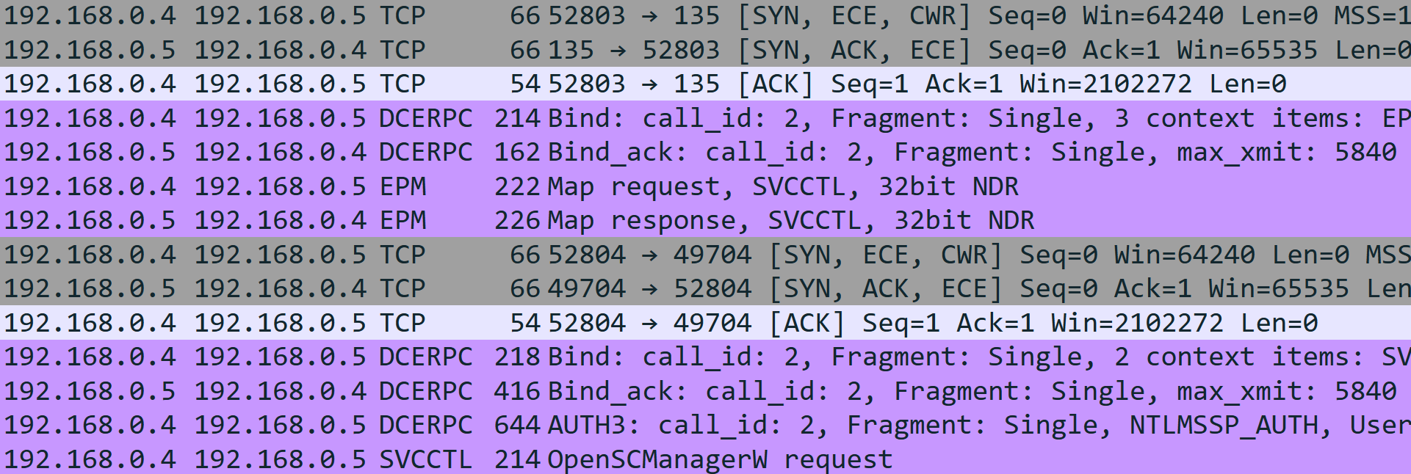
Endpoint Resolution

Slide 18
Endpoint Resolution

Slide 19
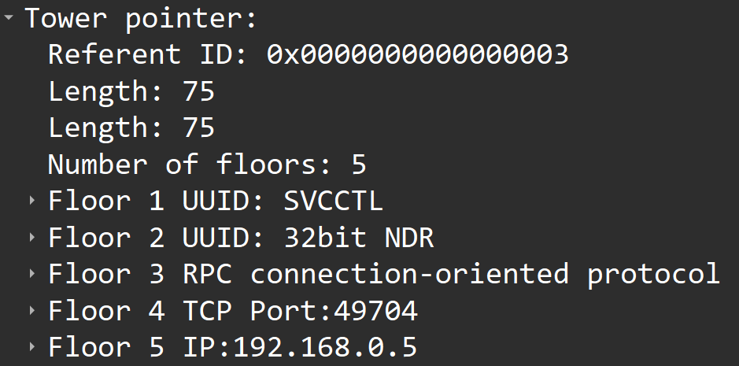
Endpoint Resolution

Slide 20
Endpoint Resolution

Slide 21
Endpoint Resolution

Slide 22
Binding

Slide 23
Binding
Establishing a context session between a client and a server
Carries details about the connection
Context
Security
Authentication
Notes:
There are several types of binding (automatic, implicit and explicit) but we will not go into this for the scope of the talk.
When the client sets authentication on the binding, the binding is considered authenticated.
https://docs.microsoft.com/en-us/windows/win32/rpc/binding-handles

Slide 24
Message Flow
Client
Server
Map request: interface <UUID>

Slide 25
Message Flow
Client
Server
Map request: interface <UUID>
Map response: endpoint

Slide 26
Message Flow
Client
Server
Map request: interface <UUID>
Map response: endpoint
Bind request

Slide 27
Message Flow
Client
Server
Map request: interface <UUID>
Map response: endpoint
Bind request
Bind response

Slide 28
Message Flow
Client
Server
Map request: interface <UUID>
Map response: endpoint
Bind request
Bind response
RPC call

Slide 29
Message Flow
Client
Server
Map request: interface <UUID>
Map response: endpoint
Bind request
Bind response
RPC call
RPC call return

Slide 30
An RPC Call’s Flow
Client
Server
Foo(5, “hello”)
Notes:
Now let’s see how an RPC call is processed.
The client first invokes the function they know is exposed by the interface.
This function calls an [c] RPC runtime function – NdrClientCall, which in turn triggers many operations in the RPC runtime: [c] marshalling the function parameters, connecting to the endpoint over the network (or not), binding, which is sort-of handshaking with the server and authenticating to it.
The RPC runtime is also compiled into the [c] server application, where is listens to incoming connections, performs access checks and unmarshalls the data sent over the network.
Eventually, the call is passed to [c] Foo which is fully implemented on the server side.
This handshake I was talking about is actually the operating system’s way to represent the session between the client and the server – this is called an RPC binding →

Slide 31
An RPC Call’s Flow
Client
Server
Foo(5, “hello”)
NdrClientCall3()
Notes:
Now let’s see how an RPC call is processed.
The client first invokes the function they know is exposed by the interface.
This function calls an [c] RPC runtime function – NdrClientCall, which in turn triggers many operations in the RPC runtime: [c] marshalling the function parameters, connecting to the endpoint over the network (or not), binding, which is sort-of handshaking with the server and authenticating to it.
The RPC runtime is also compiled into the [c] server application, where is listens to incoming connections, performs access checks and unmarshalls the data sent over the network.
Eventually, the call is passed to [c] Foo which is fully implemented on the server side.
This handshake I was talking about is actually the operating system’s way to represent the session between the client and the server – this is called an RPC binding →

Slide 32
An RPC Call’s Flow
Client
Server
Foo(5, “hello”)
NdrClientCall3()
RPC Runtime (rpcrt4.dll)
Marshall parameters
Connect to endpoint
Bind to server
Authenticate
Notes:
Now let’s see how an RPC call is processed.
The client first invokes the function they know is exposed by the interface.
This function calls an [c] RPC runtime function – NdrClientCall, which in turn triggers many operations in the RPC runtime: [c] marshalling the function parameters, connecting to the endpoint over the network (or not), binding, which is sort-of handshaking with the server and authenticating to it.
The RPC runtime is also compiled into the [c] server application, where is listens to incoming connections, performs access checks and unmarshalls the data sent over the network.
Eventually, the call is passed to [c] Foo which is fully implemented on the server side.
This handshake I was talking about is actually the operating system’s way to represent the session between the client and the server – this is called an RPC binding →

Slide 33
An RPC Call’s Flow
Client
Server
Foo(5, “hello”)
NdrClientCall3()
RPC Runtime (rpcrt4.dll)
Marshall parameters
Connect to endpoint
Bind to server
Authenticate
Listen on endpoint
Unmarshall parameters
Perform access checks
Notes:
Now let’s see how an RPC call is processed.
The client first invokes the function they know is exposed by the interface.
This function calls an [c] RPC runtime function – NdrClientCall, which in turn triggers many operations in the RPC runtime: [c] marshalling the function parameters, connecting to the endpoint over the network (or not), binding, which is sort-of handshaking with the server and authenticating to it.
The RPC runtime is also compiled into the [c] server application, where is listens to incoming connections, performs access checks and unmarshalls the data sent over the network.
Eventually, the call is passed to [c] Foo which is fully implemented on the server side.
This handshake I was talking about is actually the operating system’s way to represent the session between the client and the server – this is called an RPC binding →

Slide 34
An RPC Call’s Flow
Client
Server
Foo(5, “hello”)
Foo(5, “hello”)
NdrClientCall3()
RPC Runtime (rpcrt4.dll)
Marshall parameters
Connect to endpoint
Bind to server
Authenticate
Listen on endpoint
Unmarshall parameters
Perform access checks
Notes:
Now let’s see how an RPC call is processed.
The client first invokes the function they know is exposed by the interface.
This function calls an [c] RPC runtime function – NdrClientCall, which in turn triggers many operations in the RPC runtime: [c] marshalling the function parameters, connecting to the endpoint over the network (or not), binding, which is sort-of handshaking with the server and authenticating to it.
The RPC runtime is also compiled into the [c] server application, where is listens to incoming connections, performs access checks and unmarshalls the data sent over the network.
Eventually, the call is passed to [c] Foo which is fully implemented on the server side.
This handshake I was talking about is actually the operating system’s way to represent the session between the client and the server – this is called an RPC binding →

Slide 35
RPC → Auth → NTLM
Notes:
Let’s start with a quick RPC overview.

Slide 36
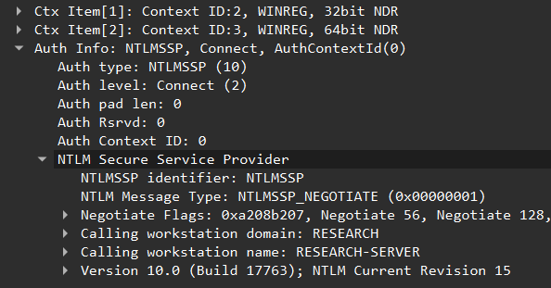
Binding & Authentication

Slide 37
Message Flow (NTLM)
Client
Server
Map request: interface <UUID>
Map response: endpoint
Bind request (neg)
Bind response (chal)
Auth3
RPC call
RPC call return

Slide 38
RPC Authentication
RPC calls are unauthenticated by default

Slide 39
RPC Authentication
RPC calls are unauthenticated by default
RPC servers must tell the runtime they want authentication support
RpcServerRegisterAuthInfo

Slide 40
RPC Authentication
RPC calls are unauthenticated by default
RPC servers must tell the runtime they want authentication support
RpcServerRegisterAuthInfo
Clients aren’t forced to authenticate
Unless server specify RPC_IF_ALLOW_SECURE_ONLY during registration

Slide 41
Server (side of) Authentication
Authentication in RPC is implemented with the Security Support Provider Interface (SSPI)
Notes:
As you must know, dlls share memory in inside the same process. The RPC runtime is also a DLL, rpcrt4, which means it is also uses the shared memory. If one RPC server adds features to the runtime, they will affect all other RPC servers inside the same process. This is because there is no interface-object binding in the runtime
Authentication providers are implemented following the SSPI - Security Support Provider Interface. Basically DLLs with a unique set of exports.
When an RPC server register an authentication service, it causes the RPC runtime to load the corresponding DLL, which is of course shared across the entire process

Slide 42
Server (side of) Authentication
Authentication in RPC is implemented with the Security Support Provider Interface (SSPI)
RPC servers wishing to use authentication must instruct the RPC runtime to load the corresponding SSPI
Notes:
As you must know, dlls share memory in inside the same process. The RPC runtime is also a DLL, rpcrt4, which means it is also uses the shared memory. If one RPC server adds features to the runtime, they will affect all other RPC servers inside the same process. This is because there is no interface-object binding in the runtime
Authentication providers are implemented following the SSPI - Security Support Provider Interface. Basically DLLs with a unique set of exports.
When an RPC server register an authentication service, it causes the RPC runtime to load the corresponding DLL, which is of course shared across the entire process

Slide 43
Server (side of) Authentication
Authentication in RPC is implemented with the Security Support Provider Interface (SSPI)
RPC servers wishing to use authentication must instruct the RPC runtime to load the corresponding SSPI
Kerberos
rpcrt4.dll
sspisrv.dll
NTLM
Negotiate
Notes:
As you must know, dlls share memory in inside the same process. The RPC runtime is also a DLL, rpcrt4, which means it is also uses the shared memory. If one RPC server adds features to the runtime, they will affect all other RPC servers inside the same process. This is because there is no interface-object binding in the runtime
Authentication providers are implemented following the SSPI - Security Support Provider Interface. Basically DLLs with a unique set of exports.
When an RPC server register an authentication service, it causes the RPC runtime to load the corresponding DLL, which is of course shared across the entire process

Slide 44
Client (side of) Authentication
RPC_STATUS RpcBindingSetAuthInfo(
RPC_BINDING_HANDLE Binding,
RPC_CSTR ServerPrincName,
unsigned long AuthnLevel,
unsigned long AuthnSvc,
RPC_AUTH_IDENTITY_HANDLE AuthIdentity,
unsigned long AuthzSvc
);

Slide 45
Client (side of) Authentication
RPC_STATUS RpcBindingSetAuthInfo(
RPC_BINDING_HANDLE Binding,
RPC_CSTR ServerPrincName,
unsigned long AuthnLevel,
unsigned long AuthnSvc,
RPC_AUTH_IDENTITY_HANDLE AuthIdentity,
unsigned long AuthzSvc
);
RPC session
Protocol
Credentials

Slide 46
Server Authentication
RPC Runtime
RPC Server
Client
Notes:
So this time, we have two interfaces, and for the sake of simplicity, both are accessible through the same endpoint

Slide 47
Server Authentication
RPC Runtime
RPC Server
RpcBindingSetAuthInfo(NTLM)
Client
Notes:
So this time, we have two interfaces, and for the sake of simplicity, both are accessible through the same endpoint

Slide 48
Server Authentication
RPC Runtime
RPC Server
✘
RPC_S_UNKNOWN_AUTHN_SERVICE
Client
Notes:
So this time, we have two interfaces, and for the sake of simplicity, both are accessible through the same endpoint

Slide 49
Server Authentication
RpcServerRegisterAuthInfo(NTLM)
RPC Runtime
RPC Server
NTLM
Client
Notes:
So this time, we have two interfaces, and for the sake of simplicity, both are accessible through the same endpoint

Slide 50
Server Authentication
RPC Runtime
RPC Server
NTLM
RpcBindingSetAuthInfo(NTLM)
Client
Notes:
So this time, we have two interfaces, and for the sake of simplicity, both are accessible through the same endpoint

Slide 51
Server Authentication
RPC Runtime
RPC Server
NTLM
✔
RPC_S_OK
Client
Notes:
So this time, we have two interfaces, and for the sake of simplicity, both are accessible through the same endpoint

Slide 52
Security
RPC_STATUS RpcBindingSetAuthInfo(
RPC_BINDING_HANDLE Binding,
RPC_CSTR ServerPrincName,
unsigned long AuthnLevel,
unsigned long AuthnSvc,
RPC_AUTH_IDENTITY_HANDLE AuthIdentity,
unsigned long AuthzSvc
);

Slide 53
Authentication Levels
RPC_C_AUTHN_LEVEL_NONE | No authentication
RPC_C_AUTHN_LEVEL_CONNECT | Authenticate when establishing a binding
RPC_C_AUTHN_LEVEL_CALL | Authenticate on each call
RPC_C_AUTHN_LEVEL_PKT | Authenticate on each packet and verify that all the data was received
RPC_C_AUTHN_LEVEL_PKT_INTEGRITY | Authenticate & verify data integrity
RPC_C_AUTHN_LEVEL_PKT_PRIVACY | Authenticate & encrypt all data

Slide 54
Authentication Levels
RPC_C_AUTHN_LEVEL_NONE | No authentication
RPC_C_AUTHN_LEVEL_CONNECT | Authenticate when establishing a binding
RPC_C_AUTHN_LEVEL_CALL | Authenticate on each call
RPC_C_AUTHN_LEVEL_PKT | Authenticate on each packet and verify that all the data was received
RPC_C_AUTHN_LEVEL_PKT_INTEGRITY | Authenticate & verify data integrity
RPC_C_AUTHN_LEVEL_PKT_PRIVACY | Authenticate & encrypt all data

Slide 55
Authentication Levels
RPC_C_AUTHN_LEVEL_NONE | No authentication
RPC_C_AUTHN_LEVEL_CONNECT | Authenticate when establishing a binding
RPC_C_AUTHN_LEVEL_CALL | Authenticate on each call
RPC_C_AUTHN_LEVEL_PKT | Authenticate on each packet and verify that all the data was received
RPC_C_AUTHN_LEVEL_PKT_INTEGRITY | Authenticate & verify data integrity
RPC_C_AUTHN_LEVEL_PKT_PRIVACY | Authenticate & encrypt all data

Slide 56
Let’s Find Some Victims
Find RPC PEs
Imports rpcrt4.dll
RpcServerRegisterAuthInfoW /
RpcBindingSetAuthInfoA
Notes:
We can easily find all PE files in a given folder (think system32 or Windows)
For each PE, we just need to find the RPC interface structures, and extract their information.

Slide 57
Let’s Find Some Victims
Find RPC PEs
Parse authentication info
Imports rpcrt4.dll
RpcServerRegisterAuthInfoW /
RpcBindingSetAuthInfoA
AuthnSvc -> NTLM/Negotiate
AuthnLevel -> Connect
Notes:
We can easily find all PE files in a given folder (think system32 or Windows)
For each PE, we just need to find the RPC interface structures, and extract their information.

Slide 58

Let’s Find Some Victims
Find RPC PEs
Parse authentication info
Profit?
Imports rpcrt4.dll
RpcServerRegisterAuthInfoW /
RpcBindingSetAuthInfoA
AuthnSvc -> NTLM/Negotiate
AuthnLevel -> Connect
Notes:
We can easily find all PE files in a given folder (think system32 or Windows)
For each PE, we just need to find the RPC interface structures, and extract their information.

Slide 59
Windows Remote Registry
Notes:
Let’s start with a quick RPC overview.

Slide 60
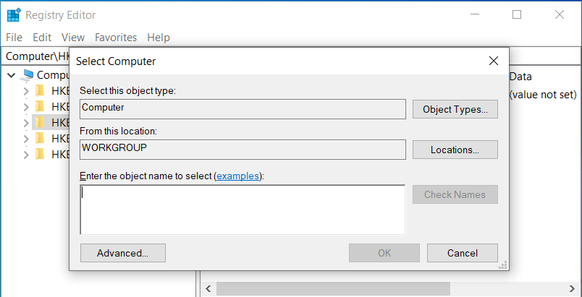
RPC Interface: MS-RRP
Interface UUID: {338CD001-2244-31F1-AAAA-900038001003}
Well known endpoint: \PIPE\winreg
RPC server implemented in regsvc.dll
RPC client implemented in advapi32.dll
https://learn.microsoft.com/en-us/openspecs/windows_protocols/ms-rrp/0fa3191d-bb79-490a-81bd-54c2601b7a78

Slide 61
Why Is It Special?
v12 = RpcBindingSetAuthInfoA(Binding, (RPC_CSTR)&ServerPrincName, 2u, 0xAu, 0i64, 0);
v12 = RpcBindingSetAuthInfoW(Binding, v19, 6u, 9u, AuthzSvc, (unsigned int)AuthzSvc);

Slide 62
Why Is It Special?
v12 = RpcBindingSetAuthInfoA(Binding, (RPC_CSTR)&ServerPrincName, 2u, 0xAu, 0i64, 0);
v12 = RpcBindingSetAuthInfoW(Binding, v19, 6u, 9u, AuthzSvc, (unsigned int)AuthzSvc);

Slide 63
Why Is It Special?
v12 = RpcBindingSetAuthInfoA(Binding, (RPC_CSTR)&ServerPrincName, 2u, 0xAu, 0i64, 0);
RPC_C_AUTHN_LEVEL_CONNECT
v12 = RpcBindingSetAuthInfoW(Binding, v19, 6u, 9u, AuthzSvc, (unsigned int)AuthzSvc);
RPC_C_AUTHN_LEVEL_PKT_PRIVACY

Slide 64
Callstack
RpcBindingSetAuthInfoA
RpcBindingSetAuthInfoW

Slide 65
Callstack
BaseBindToMachine
RpcBindingSetAuthInfoA
RpcBindingSetAuthInfoW

Slide 66
Callstack
RegConnectRegistryExW
BaseBindToMachine
RpcBindingSetAuthInfoA
RpcBindingSetAuthInfoW

Slide 67
Callstack
RegConnectRegistryW
RegConnectRegistryExW
BaseBindToMachine
RpcBindingSetAuthInfoA
RpcBindingSetAuthInfoW

Slide 68
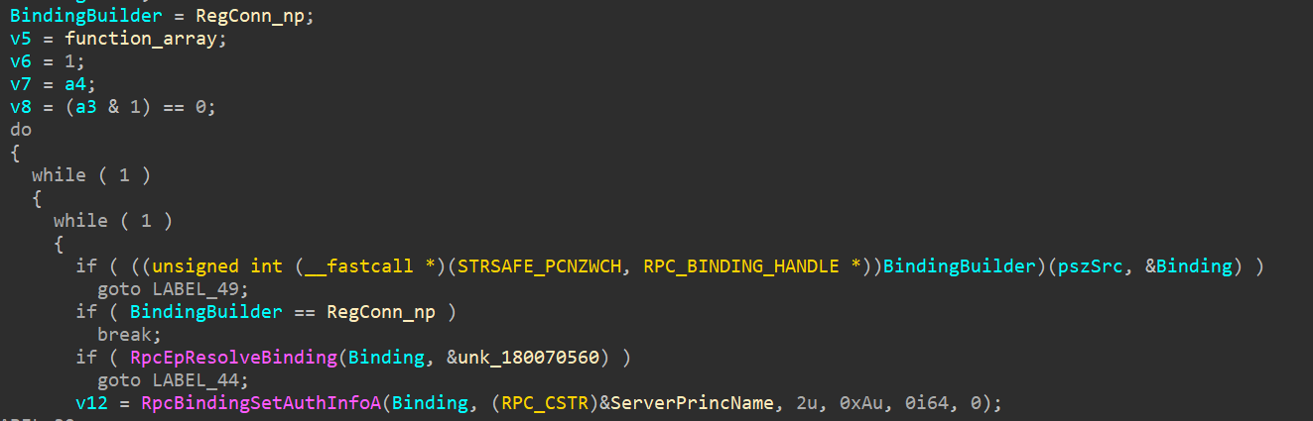
Transport Fallback

Slide 69
Transport Fallback
Tries to connect via RPC over SMB (ncacn_np) — \PIPE\winreg
On failure, tries to use other transport protocols:
SPX — ncacn_spx
TCP — ncacn_ip_tcp
NetBEUI — ncacn_nb_nb
NetBIOS — ncacn_nb_tcp
IPX — ncacn_nb_ipx

Slide 70
Transport Fallback
Tries to connect via RPC over SMB (ncacn_np) — \PIPE\winreg
On failure, tries to use other transport protocols:
SPX — ncacn_spx OBSOLETE
TCP — ncacn_ip_tcp
NetBEUI — ncacn_nb_nb OBSOLETE
NetBIOS — ncacn_nb_tcp OBSOLETE
IPX — ncacn_nb_ipx OBSOLETE

Slide 71
Transport Fallback
Tries to connect via RPC over SMB (ncacn_np) — \PIPE\winreg
On failure, tries to use other transport protocols:
SPX — ncacn_spx OBSOLETE
TCP — ncacn_ip_tcp
NetBEUI — ncacn_nb_nb OBSOLETE
NetBIOS — ncacn_nb_tcp OBSOLETE
IPX — ncacn_nb_ipx OBSOLETE
SMB transport is PKT_PRIVACY, fallbacks are CONNECT

Slide 72
Attack Chain
Client
Attacker
Server

Slide 73
Attack Chain
Client
Attacker
Server
SMB: \PIPE\winreg
SMB: No such file

Slide 74
Attack Chain
Client
Attacker
Server
SMB: \PIPE\winreg
SMB: No such file
SPX: <WinReg>
RST

Slide 75
Attack Chain
Client
Attacker
Server
SMB: \PIPE\winreg
SMB: No such file
SPX: <WinReg>
RST
TCP: <WinReg+Auth>
Auth

Slide 76
Attack Chain
Client
Attacker
Server
SMB: \PIPE\winreg
SMB: No such file
SPX: <WinReg>
RST
TCP: <WinReg+Auth>
Auth
Challenge

Slide 77
Attack Chain
Client
Attacker
Server
SMB: \PIPE\winreg
SMB: No such file
SPX: <WinReg>
RST
TCP: <WinReg+Auth>
Auth
TCP: <Bind+Challenge>
Challenge

Slide 78
Attack Chain
Client
Attacker
Server
SMB: \PIPE\winreg
SMB: No such file
SPX: <WinReg>
RST
TCP: <WinReg+Auth>
Auth
TCP: <Bind+Challenge>
Challenge
Auth
Auth

Slide 79
Relay Targets
Can’t relay to RPC servers that require PKT_PRIVACY

Slide 80
Relay Targets
Can’t relay to RPC servers that require PKT_PRIVACY
Encryption is derived from shared secret — the password
SCM, Task scheduler

Slide 81
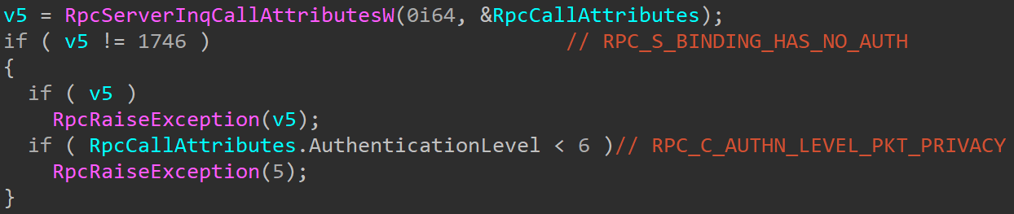
Relay Targets
Can’t relay to RPC servers that require PKT_PRIVACY
Encryption is derived from shared secret — the password
SCM, Task scheduler
Winreg server as well, surprisingly

Slide 82




ADCS Relay
Victim
RegConnectRegistry()
ADCS

Slide 83

ADCS Relay
Victim
ADCS

Slide 84
ADCS Relay
Victim
ADCS

Slide 85

ADCS Relay
Victim
ADCS

Slide 86

ADCS Relay
Victim

Slide 87
Demo

Slide 88
Potential Impact
Vulnerability is in Windows API — who the hell calls it?
regedit
ADCS
Certutil
DFS Namespaces
taskview/taskkill
Windows Event Viewer

Slide 89
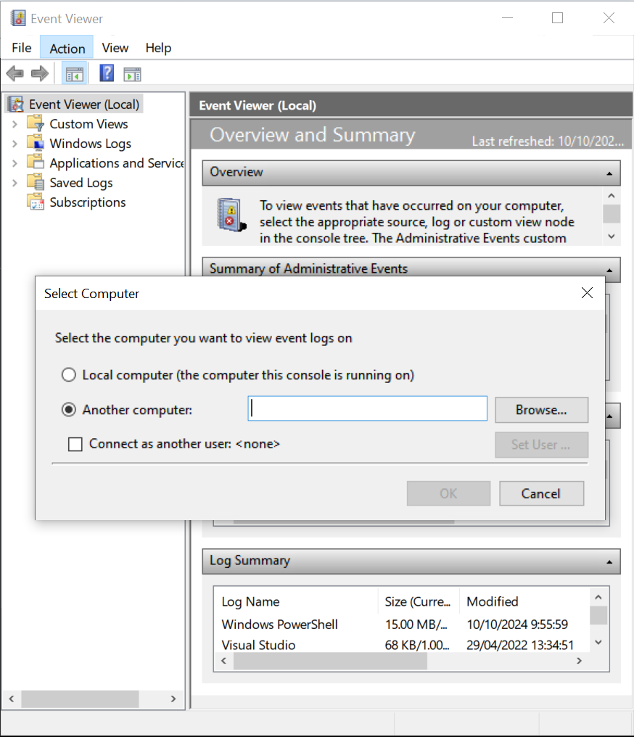
Event Viewer?
Can query logs remotely via RPC MS-EVEN[6]
Quick Google search shows people actually use it to view logs remotely
Implemented as an .msc for mmc.exe
Most logic is in els.dll

Slide 90
Event Viewer - Exploitation
Classic MitM for NTLM relay

Slide 91
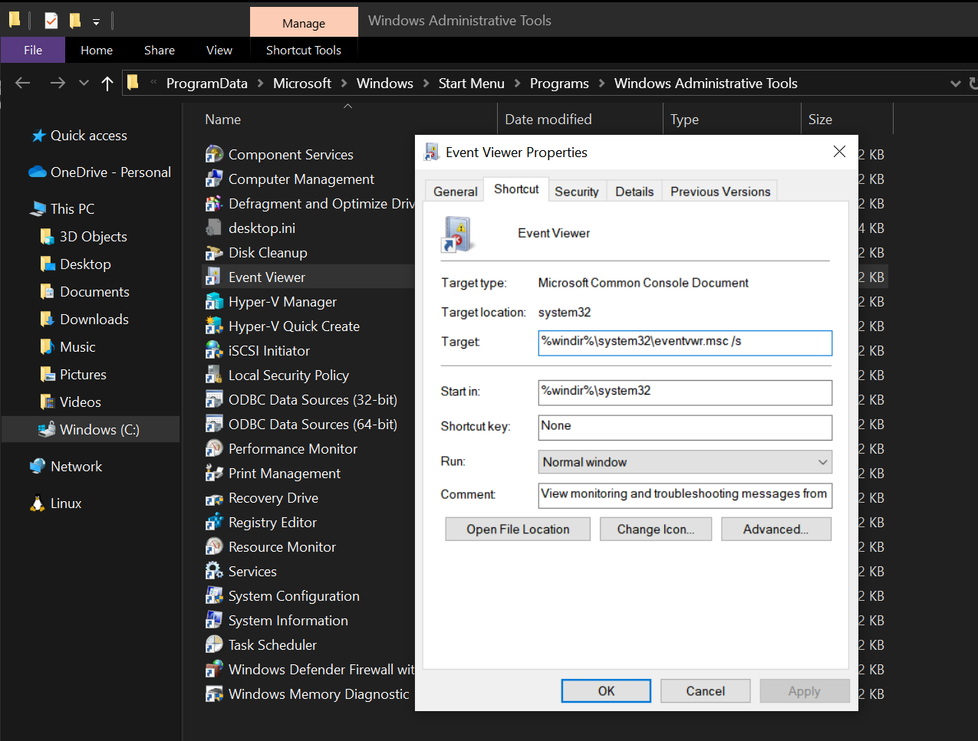
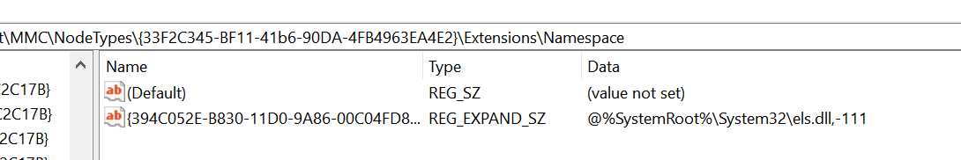
Event Viewer - Exploitation
Classic MitM for NTLM relay
Modify the Event Viewer shortcut for persistent pseudo coercion
Modify the registry to load a modified els.dll

Slide 92
Event Viewer - Exploitation
Classic MitM for NTLM relay
Modify the Event Viewer shortcut for persistent pseudo coercion
Modify the registry to load a modified els.dll
Requires administrative privileges

Slide 93
Event Viewer - Exploitation Benefits
CVE patch uses new internal function - RegpCalculateConnectionFlags
Function checks new registry values for verdict

Slide 94
Event Viewer - Exploitation Benefits
CVE patch uses new internal function - RegpCalculateConnectionFlags
Function checks new registry values for verdict
Software\Microsoft\RemoteRegistryClient\TransportFallbackPolicy

Slide 95
Event Viewer - Exploitation Benefits
CVE patch uses new internal function - RegpCalculateConnectionFlags
Function checks new registry values for verdict
Software\Microsoft\RemoteRegistryClient\TransportFallbackPolicy
Attacker can set Event Viewer “backdoor”
Attacker can set transport policy
==

Slide 96


Slide 97
The Disclosure Process
Open vulnerability disclosure
Report on RegConnectRegistryExW with half working PoC — no actual relay
Reopen vulnerability disclosure
Report on RegConnectRegistryW with better PoC — adcs relay
Vulnerability patched
CVE-2024-43532 - EoP 8.8 CVSS
April
July
February
June
October
Report closed
Marked as documentation issue as RegConnectRegistryExW contains a flag to prevent fallback
Vulnerability confirmed

Slide 98
Further Research
Look for more relay-able RPC clients
They seem more overlooked compared to RPC servers
Coerce outbound Winreg on components that use RegConnectRegistryW

Slide 99
Thanks for listening
Questions?

